Slide 1

Current Global Deployment Status
Fundamentals of 5G Wireless Networks
Video 3.5

Slide 2
5G Deployments
172 5G network operators and over 78,000 cell sites.
(https://www.speedtest.net/ookla-5g-map)
7 Countries and 11 operators with 5G SA.
(https://en.wikipedia.org/wiki/List_of_5G_NR_networks)
Country | Operator
Canada | Rogers
China | China Telecom, China Mobile, China Unicom
Columbia | DIRECTV
Germany | Vodafone, Telefonica
Kuwait | STC
Singapore | Singtel, StarHub
USA | T-Mobile

Slide 3
5G Equipment
Over 700 5G devices with 351 5G phones.
431 commercially available devices.
Other devices include Wi-Fi hotspots, FWA CPE, industrial IoT, laptops, and tablets.
(https://gsacom.com/paper/5g-market-snapshot-april-2021-executive-summary/)

Slide 4
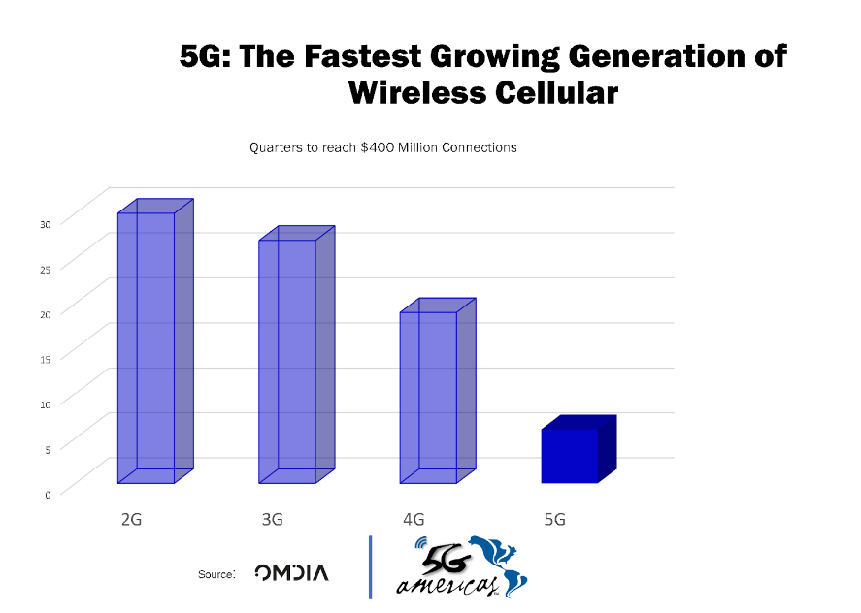
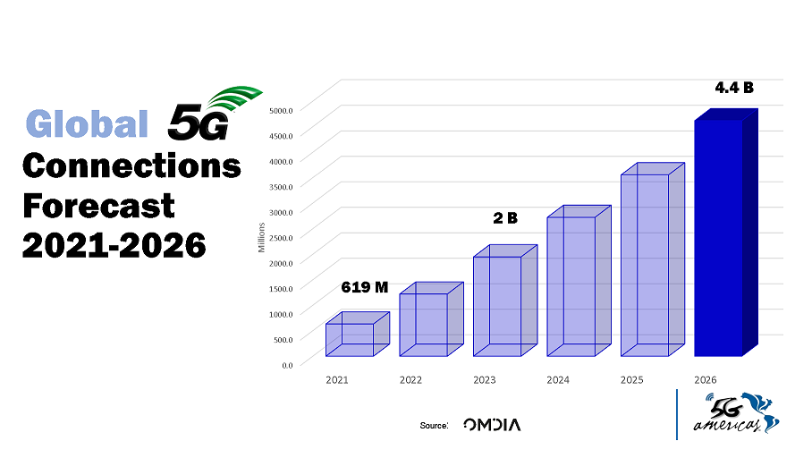
5G Growth
Charts courtesy of 5G Americas, TeleGeography, and Omdia.
Notes:
These charts are used with permission of 5G Americas, TeleGeography and Omdia.
https://www.5gamericas.org/resources/charts-statistics/global/

Slide 5
49.4%
Amount of 2020 world investment in 5G attributed to China
Notes:
Something that needs to grab the viewers attention!!

Slide 6
UE, RAN, and Core Threats
Next Video

